Slide 1
Chapter Three Memory Management
What is memory?
Memory is one of the most important resources of the computer system that is used to store data and programs.
The part of the operating system that manages memory is called the Memory Manager (MM).
The main functions of the Memory Manager (MM) are the following:
Keeping track of which part of memory are in use and which parts are free
Allocating and deallocating memory to processes.
Managing swapping between memory and disk when memory is not big enough to hold all the processes.

Slide 2
Cont…
When we said a memory manager is a good/best?
If it is fulfill the following basic characteristics/attributes, we can call a good memory manager.
It allows all processes to run-fair scheduling
Its memory (space used for the management activity) overhead must be reasonable.
Its time overhead (time required for the management activity) is reasonable

Slide 3
Type of Memory Management Schemes
Mono-programming – Only one program will be run in the memory in addition to the operating system.
Multiprogramming - It allows multiple programs to run/load in parallel.
In order to load multiple programs in parallel ways a memory should be partitioned/divide.

Slide 4
Memory Partitioning
There are two partitioning options – fixed partitioning and Dynamic partitioning
Fixed partitioning – partitioning is done before the processes comes to memory.
Advantage of fixed portioning
It is simple to implement
It requires minimal management overhead(both time and space mgt).
Disadvantages of fixed partitioning
Inefficient use of memory b/c some of the partition may be idle.
Limits number of active processes b/c the memory partition is limited.
A program may be too big too fit in any of the partitions.
Dynamic partitioning – partitioning is done when processes request memory space

Slide 5
Cont….
With dynamic partitions since a process is allocated exactly as much memory it requires.
But, if a process runs out of the extra space allocated to it, either
It may be moved to a hole with enough space or
It may be Swapped out of memory until a large enough hole can be created or
Kill the process.

Slide 6
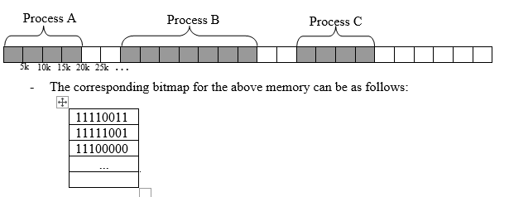
Memory usage management
There are two ways to keep free and allocated memory areas, bitmap and linked list
Bitmaps
Bitmap means dividing the memory into fixed size allocation units. e.g. 5k,10k or 8bit, 16bit...
Each allocation unit is represented with a bit in the bit map.
If the bit is 0, it means the allocation unit is free and if it is 1, it means it is occupied
Example: Look at the following portion of a memory. Let the size of the allocation units is 5k as shown in the diagram.

Slide 7
ii. Linked Lists
A linked list used to allocated and free up a memory segments
Each segment is either a process or a hole between two processes and contains a number of allocation units
Each entry in the list consists of
Segment type: P/H (1bit)
The address at which it starts
The length of the segment
A pointer to the next entry
The list is kept sorted by address. Sorting important to updating easily when processes terminates or is swapped out.
Example: The memory in the bitmap example can be represented using linked list as follows:

Slide 8
Virtual Memory
A process may be larger than the available main memory, in the early day’s overlays were used to solve this problem. i.e.
The programmer will divide the program into modules and the main program is responsible for switching the modules in and out of memory as needed.
Drawback: The programmer must know how much memory is available and it wastes the programmer time.
But using a virtual memory mgt a computer allows to manage a physical memory shortages by temporary transferring of data from disk to memory. i.e. It allows piece of programs are swapped between disk and memory as needed.
Virtual memory implementation techniques:
Paging: It allows a memory divided into fixed sized block size.
Segmentation: It allows a memory space divided into segments of the variable block size.

Slide 9
Assignment##
1. Discuss briefly the five memory allocation/placement algorithms (First-Fit, Next Fit, Best Fit, Worst Fit and Quick Fit algorithms) and write the algorithms for each allocation algorithm?
2. Write briefly the 2 virtual memory implementation techniques:
Paging
Segmentation

Slide 10

Thank You!!!

